Slide 1
TRENDWAVE MARKETING ANALYSIS
PRESENTER: GUNTAS SINGH
DATE: 9/9/2025

Slide 2
Business Context & Problem
TrendWave has run paid campaigns across Facebook, Instagram, Twitter, and LinkedIn over a three-month period. The company has collected granular data on daily impressions, clicks, conversions, ad spend, and demographic breakdowns. Despite substantial investment, there is no clarity on which platforms, creatives, and audience segments deliver the best value.
With quarterly targets approaching, the company needs an analytical framework to:
Allocate ad budgets across platforms for optimal cost per acquisition (CPA)
Compare performance across audience demographics and segments
Identify underperforming campaigns for reallocation or optimization
Detect time-based performance trends and seasonality
Provide evidence-backed recommendations for the next product launch

Slide 3
DATA OVERVIEW
ad_id | A unique ID for each ad
xyzcampaignid | An ID associated with each campaign of XYZ company
fbcampaignid | An ID associated with how Facebook tracks each campaign
age | Age of the person shown the ad
gender | Gender of the person shown the ad
interest | A code specifying the interest category of the person (from their public Facebook profile)
Impressions | Number of times the ad was shown
Clicks | Number of clicks on the ad
Spent | Amount spent on the ad
Total conversion | Number of people who enquired about the product
Approved conversion | Number of people who bought the product
CPM (Cost per Mille) | It is a metric that represents the cost of displaying an ad to 1,000 people. In other words, it measures how much a business pays for every 1,000 ad impressions.
Cost per click (CPC) | It is a metric that represents the cost of getting a user to click on an ad. It measures how much a business pays for every click on their ad.
Click-through rate (CTR) | It is a metric that represents the percentage of users who click on an ad after seeing it. It measures the effectiveness of an ad in getting users to click through to a website or landing page.
CPA (Cost per Acquisition) | It is a metric that represents the cost of acquiring a new customer through an ad campaign. It measures how much a business pays for every new customer acquired through their ad.

Slide 4
DATA CLEANING
PROBLEM: Upon checking the data, I realized that there are some rows (176) where conversion > 0 but clicks are zero, which is a bit illogical and indicates that the data is inconsistent.
SOLUTION: As this is for more than 11 % of the data, rather than excluding it we need to find a logical way to impute the data.
APPROACH: We can impute the data with average number of clicks we are getting but that can be influenced by the outliers. So, we are first grouping the impressions data that we have and then calculating the average clicks for each particular group In this way we can avoid outliers and impute the data without affecting the analysis
STEPS : 1) Filtering data for rows having 0 clicks and 1 or more conversions.
2) Create a pivot table on the filtered table with rows having impressions, having groups of 1000 each and values having the
average clicks of each group.
3) Using Xlookup imputing the data from the pivot table.
FORMULA USED: XLOOKUP(TRUE,(B2>=RANGE)*(B2<=RANGE)=1,RANGE)

Slide 5
DATA CLEANING (CONT.)
PROBLEM 2:
Similarly, we see that where conversions were greater than 0 and clicks were 0, amount spent was also zero.
This could hamper our analysis as we are getting customers without any amount spent, which will lead to underestimation of metrics like CPA (Cost Per Acquisition)
SOLUTION
As this is for more than 11 % of the data, rather than excluding it we need to find a logical way to impute the data. Upon researching, I found out that companies like facebook, Instagram charge according to the clicks on the AD. So we can use the no of clicks data to find out average amount spent on every click.
APPROACH:
We can impute the data with average amount spent per clicks.
So, we are first grouping the clicks data that we have and then calculating the average clicks for each particular group In this way we can avoid outliers and impute the data without affecting the analysis
STEPS: 1) Create a pivot table with rows having clicks, and values having the average amount spent.
2) Filtering data for rows having 0 spent and 1 or more clicks.
3) Using Xlookup imputing the data from the pivot table.
FORMULA USED: XLOOKUP(TRUE,(B2>=RANGE)*(B2<=RANGE)=1,RANGE)

Slide 6
KPI METRICS USED IN ANALYSIS

Slide 7
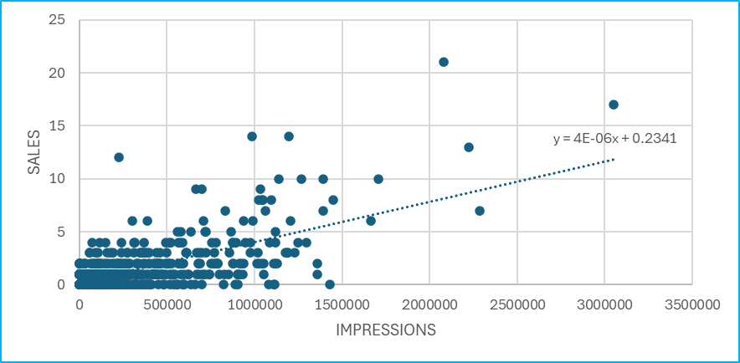
Exploratory Data Analysis (EDA)
HYPOTHESIS 1:
Higher impressions means higher sale
To prove the above hypothesis we will do a correlation analysis between impressions and sales.
Correlation: 0.684
Correlation metric shows moderately positive correlation between impressions and sales
Hence we can conclude that the hypothesis is fairly proven, which shows that reaching out to higher number of people will result in increased sales.
ACTIONABLE INSIGHT:
Focus on increasing Impressions for high-performing campaigns or target audiences to drive more approved conversions.

Slide 8
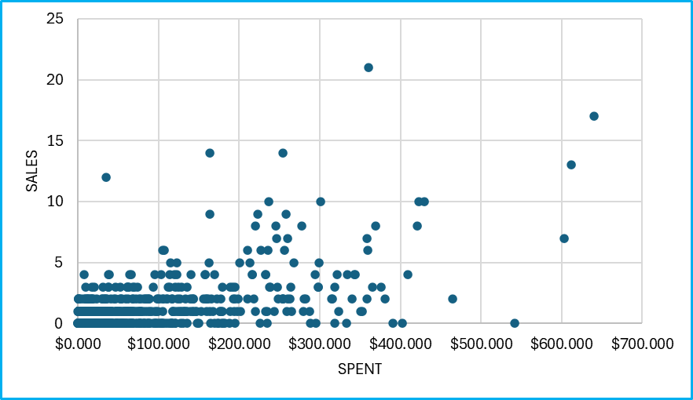
Exploratory Data Analysis (cont.)
HYPOTHESIS 2: Higher spent means higher sales
Correlation: 0.593
ACTIONABLE INSIGHT:
This shows a sort of a weak positive correlation, which means that only amount spent is not affecting sales, we need to focus on optimizing AD spend efficiency.

Slide 9
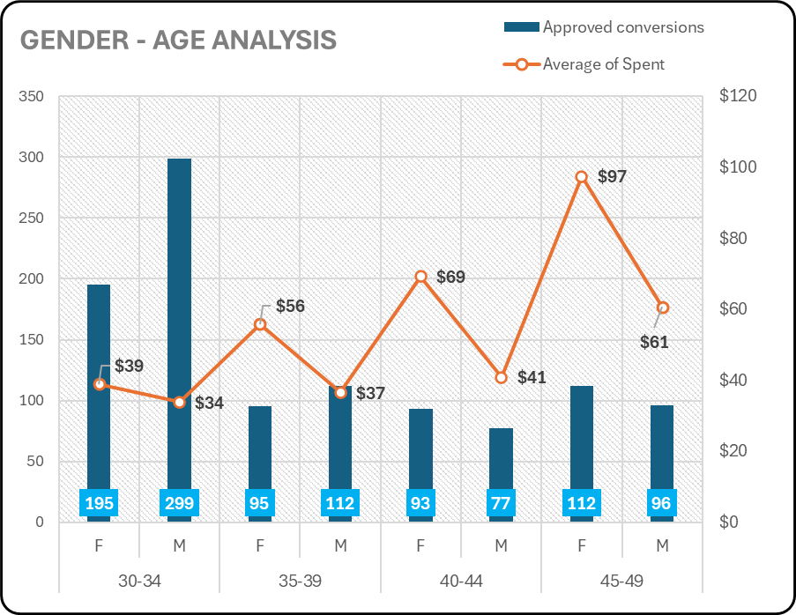
DEMOGRAPHIC ANALYSIS
OBSERVATIONS AND ACTIONABLE INSIGHTS:
Male population within age 30-34 contributes to the highest sales (299) while having a lower average AD spend ($ 34), which means higher conversion efficiency.
2) On the other hand, females within age group 45-49 has the highest average AD spend ($ 97), even then the sales we are getting is very low, which shows a need to reconsider the target groups for AD campaigns.
3) Overall, 30-34 age group has the highest contribution towards sales with lower AD spend, more focused marketing strategies are required to tap this particular age segment.

Slide 10
DEMOGRAPHIC ANALYSIS (DEEP DIVE 1)
OBSERVATIONS:
We can see results consistent to the above analysis.
CPA for 30-34 age group is much lower than the other age groups.
This shows that on an average business has to pay lesser to acquire a customer from age group 30-34.

Slide 11
DEMOGRAPHIC ANALYSIS (DEEP DIVE 2)
Insights:
Even the cost to reach 1000 customers is lower for 30-34 age group people followed by 35-39 age group.
Which can be due to more social media presence.
Conversion Rate for 30-34 age group is far better than other groups.
Which means more people of this age group are buying the product after clicking the AD.

Slide 12
DEMOGRAPHIC ANALYSIS: CONCLUSION
According to the demographic analysis we can conclude that for the upcoming product launches to ensure maximum ROI and efficient budget allocation we need to focus more on younger age groups i.e. 30-34 and 35-39 due to the below reasons:
1) 30-34 age group has the highest contribution towards sales with lower AD spend, more focused marketing strategies are required to tap this particular age segment.
1) Cost Per Mile analysis shows reaching out to these age groups is easier and cost efficient, hence we need to reconsider budget allocation.
2) Cost per Acquisition analysis shows that the business can acquire more customers of these age groups without spending much on marketing.
3) Conversion rate shows people of this age group are buying more after clicking the AD.

Slide 13
CAMPAIGN ANALSYIS
INDEX
XYZ Campaign ID | Name
916 | Campaign A
936 | Campaign B
1178 | Campaign C

Slide 14
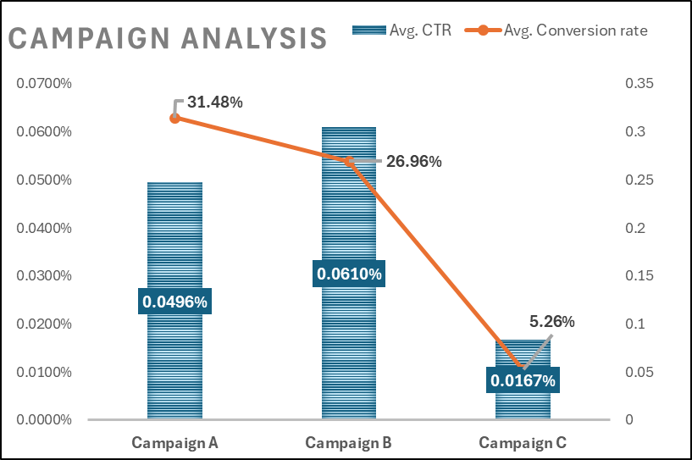
Campaign analysis: actionable insights
1) Campaign A is the most effective in terms of converting clicks into sales, hence making it a right choice for future product launches.
2) Campaign B has the highest click through rate among all three campaigns, efforts can be made to improve the conversion rate which will make it a perfect choice.
3) Hence, we can understand the audience targeting strategy from campaign B for future product launches combining with more efficient conversion strategies like discounts, vouchers etc.

Slide 15
BUDGET OPTIMIZATION ANALYSIS
CPA (Cost per Action)
The lowest CPA is in 30-34 M ($ 10) → Best cost efficiency for conversions.
The highest CPA is in 45-49 F ($ 36) → Least cost-efficient demographic.
CPM (Cost per Mile)
The highest CPM is seen in 40-44 F (₹0.32) → Suggests less cost-efficient exposure.
The lowest CPM is seen in 30-34 M ($0.15) → Shows cost efficient reach.
ACTIONABLE INSIGHTS
Prioritize budgets toward the 30-34 M segment due to the lowest CPA and CPM → Best ROI.
Reconsider or optimize targeting for 40-44 F, as it has high CPA and CPM → Potential waste of budget.

Slide 16
INTEREST GROUP ANALYSIS
OBSERVATIONS AND ACTIONABLE INSIGHTS
1. Some interest groups have noticeably higher average Conversion rates.
2. We can focus ad campaigns on the top-performing interest groups to maximize approved conversions.
3. Avoid or reconsider spending on low-performing interest groups to improve ROI.

Slide 17
Insights & recommendations
1) Total Conversion is strongly linked to Approved Conversion (~0.87), optimizing strategies that increase total conversions (e.g., better targeting, improved creatives) will likely improve Approved Conversions.
2) Since neither Impressions nor Spend significantly influence Approved Conversion directly, avoid blindly increasing impressions or ad spend without focusing on conversion optimization.
3) 30-34 age group has the highest contribution towards sales with lower AD spend, more focused marketing strategies are required to tap this particular age segment.
4) Analyzing different metrics like CPM, CPA, conversion rate etc. we can conclude that for the upcoming product launches to ensure maximum ROI and efficient budget allocation we need to focus more on younger age groups i.e. 30-34 and 35-39.

Slide 18
Insights & recommendations (cont.)
Analyzing different campaigns, we can understand the audience targeting strategy from campaign B for future product launches combining with more efficient conversion strategies like discounts, vouchers etc.
As per cost analysis the most cost efficient age group is 30 - 34 especially male population with least Cost Per Acquisition ( $10.33 ), Hence we should Prioritize budgets toward the 30-34 M segment due to the lowest CPA and CPM → Best ROI.
Reconsider or optimize targeting for 40-44 F, as it has high CPA and CPM → Potential waste of budget.
Interest group analysis: some interest groups like 65, 31, 15 etc. have noticeably higher average Conversion rates.
We can focus ad campaigns on the top-performing interest groups to maximize approved conversions and avoid or reconsider spending on low-performing interest groups to improve ROI.

Slide 19
TOOLS/LIBRARIES USED
EXCEL:
Excel was used for understanding the data, data cleaning, EDA and deriving actionable insights from the data.
PYTHON ( libraries: pandas, matplotlib and seaborn):
Python was used to generate a correlation matrix for a visual representation of correlation between different numerical variables
POWER BI:
Power Bi was used to create interactive dashboards with slicers and drill throughs.

